Slide 1
Introduction to React

Slide 2
Objectives
Overview Front-end JavaScript frameworks and libraries
Understand the architecture of an React application
Scaffold out a starter React application using create-react-app, the command line tool

Slide 3
Overview Front-End JavaScript Frameworks and Libraries

Slide 4
Why JavaScript Libraries/Frameworks?
Complexity of managing DOM manipulation and data updates manually
Well defined application architectures:
Model View Controller / Model View View Model / Model View Whatever
Binding of model and view: controllers, view models
Flux architecture / Redux

Slide 5
Software Library
Collection of implementations of behavior with a well-defined interface by which the behavior is invoked
Reuse of behavior
Modularity
E.g., jQuery
https://en.wikipedia.org/wiki/Library_(computing)

Slide 6
Software Framework
Abstraction in which software provides generic functionality that can be selectively changed by additional user-written code
Universal, reusable environment that provides particular functionality as part of a larger software platform
E.g., Angular, Ember, Backbone
https://en.wikipedia.org/wiki/Software_framework

Slide 7
Library vs Framework
The following borrowed from AngularJS documentation makes the distinction clear:
a library - a collection of functions which are useful when writing web apps. Your code is in charge and it calls into the library when it sees fit. E.g., jQuery.
frameworks - a particular implementation of a web application, where your code fills in the details. The framework is in charge and it calls into your code when it needs something app specific. E.g., Angular, Ember, etc.
https://docs.angularjs.org/guide/introduction

Slide 8
Framework
Hollywood Principle
Don’t call us, we’ll call you!
Inversion of Control
Imperative vs Declarative Programming

Slide 9
JavaScript Frameworks
Single Page Application
Rich Internet Applications
Model-View-Controller (MVC) / Model-View- ViewModel (MVVM) / Model-View-Whatever
Data binding, routing
Scalable, Reusable, Maintanable JS code
Test driven development

Slide 10
JavaScript Frameworks/Libraries
Angular
Ember
Backbone
React
Aurelia
Meteor
Polymer
Knockout
Vue
Mercury

Slide 11

Don’t Overreact
So, is React a Library or a Framework?

Slide 12
Introduction to React

Slide 13
What is React?
A JavaScript library for building user interfaces
Declarative
Component-based
Technology stack agnostic

Slide 14
React History
React
Designed by Jordan Walke
First deployed on Facebook's newsfeed in 2011
Open-sourced at JSConf US in May 2013
Designed for speed, simplicity, and scalability
https://en.wikipedia.org/wiki/React_(JavaScript_library)

Slide 15
React Vocabulary
One-way data flow
JSX
Components
State
Props
Virtual DOM
Element
Flux / Redux
Testing

Slide 16
Exercise 22: Getting Started with React
Install create-react-app
Scaffold out a basic React application

Slide 17
React Application Overview

Slide 18
React Element
Smallest building blocks of React apps
const element = <h1 className="App-title">Welcome to React</h1>;
Plain JS objects that are
Cheap to create
Components are “made of” elements
class App extends Component { . . . }

Slide 19
Rendering to the DOM
Rendered using ReactDOM. See index.js
ReactDOM.render(<App />, document.getElementById('root’));
Where is it rendered? See index.html
<div id="root"></div>
Root DOM node

Slide 20
Introduction to JSX

Slide 21
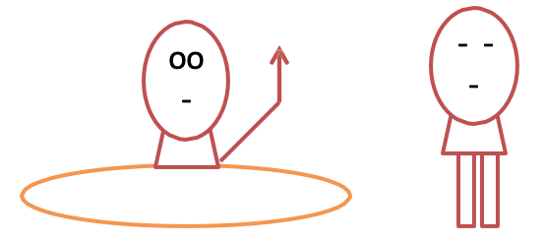
Introduction to JSX
const element = <h1>Hello, world!</h1>;
Waiter, what’s this HTML tag doing in my code?

Slide 22
JSX
Syntactic extension to JavaScript
Shorthand notation to represent JavaScript functions calls that evaluate to JavaScript objects
Avoids artificial separation of rendering logic from other UI logic

Slide 23
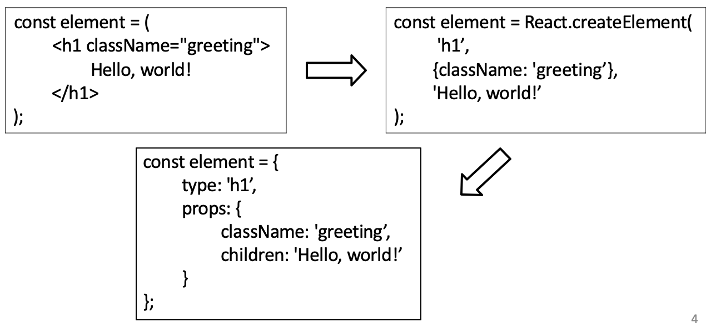
JSX

Slide 24
Embedding Expressions in JSX
const dish = { id: 0, name:'Uthappizza’, . . .};
return (
<div key={dish.id} className="col-12 mt-5">
<Media tag="li">
<Media body className="ml-5">
<Media heading>{dish.name}</Media>
</Media>
</Media>
</div>
);

Slide 25
Exercise 23: Configuring your React Application
Configure your React project to use reactstrap.
Start using reactstrap components in your application

Slide 26
Summary
Overview Front-end JavaScript frameworks and libraries
Understand the architecture of an React application
Scaffold out a starter React application using create-react-app, the command line tool

